Slide 1

3
DIFFERENTIATION RULES

Slide 2
DIFFERENTIATION RULES
3.8
Exponential Growth
and Decay
In this section, we will:
Use differentiation to solve real-life problems
involving exponentially growing quantities.

Slide 3
EXPONENTIAL GROWTH & DECAY
In many natural phenomena,
quantities grow or decay at a rate
proportional to their size.

Slide 4
EXAMPLE
For instance, suppose y = f(t) is
the number of individuals in a population
of animals or bacteria at time t.
  Then, it seems reasonable to expect that the rate
  of growth f’(t) is proportional to the population f(t).
  That is, f’(t) = kf(t) for some constant k.

Slide 5
EXPONENTIAL GROWTH & DECAY
Indeed, under ideal conditions—unlimited
environment, adequate nutrition, and
immunity to disease—the mathematical
model given by the equation f’(t) = kf(t)
predicts what actually happens fairly
accurately.

Slide 6
EXAMPLE
Another example occurs in nuclear
physics where the mass of a radioactive
substance decays at a rate proportional
to the mass.

Slide 7
EXAMPLE
In chemistry, the rate of a unimolecular
first-order reaction is proportional to
the concentration of the substance.

Slide 8
EXAMPLE
In finance, the value of a savings
account with continuously compounded
interest increases at a rate proportional
to that value.

Slide 9
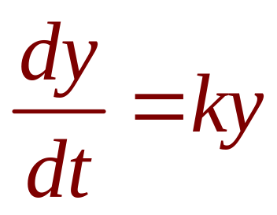
EXPONENTIAL GROWTH & DECAY
Equation 1
In general, if y(t) is the value of a quantity y
at time t and if the rate of change of y with
respect to t is proportional to its size y(t)
at any time, then
where k is a constant.

Slide 10
EXPONENTIAL GROWTH & DECAY
Equation 1 is sometimes called the law of
natural growth (if k > 0) or the law of natural
decay (if k < 0).
It is called a differential equation because
it involves an unknown function and its
derivative dy/dt.

Slide 11
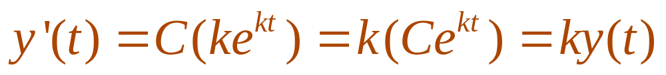
EXPONENTIAL GROWTH & DECAY
It’s not hard to think of a solution of
Equation 1.
  The equation asks us to find a function whose
  derivative is a constant multiple of itself.
  We have met such functions in this chapter.
  Any exponential function of the form y(t) = Ce^{kt},
  where C is a constant, satisfies

Slide 12
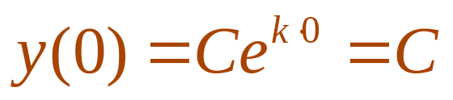
EXPONENTIAL GROWTH & DECAY
We will see in Section 9.4 that any
function that satisfies dy/dt = ky must be
of the form y = Ce^{kt}.
  To see the significance of the constant C,
  we observe that
  Therefore, C is the initial value of the function.

Slide 13
EXPONENTIAL GROWTH & DECAY
Theorem 2
The only solutions of the differential
equation dy/dt = ky are the exponential
functions
y(t) = y(0)e^{kt}

Slide 14
POPULATION GROWTH
What is the significance of
the proportionality constant k?

Slide 15
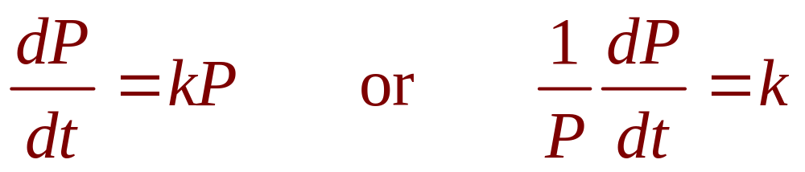
POPULATION GROWTH
Equation 3
In the context of population growth,
where P(t) is the size of a population
at time t, we can write:

Slide 16
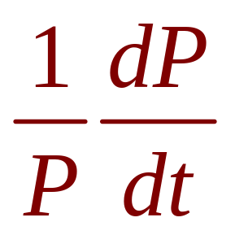
RELATIVE GROWTH RATE
The quantity
is the growth rate divided by
the population size.
  It is called the relative growth rate.

Slide 17
RELATIVE GROWTH RATE
According to Equation 3, instead of saying
“the growth rate is proportional to population
size,” we could say “the relative growth rate
is constant.”
  Then, Theorem 2 states that a population
  with constant relative growth rate must grow exponentially.

Slide 18
RELATIVE GROWTH RATE
Notice that the relative growth rate k
appears as the coefficient of t in the
exponential function Ce^{kt}.

Slide 19
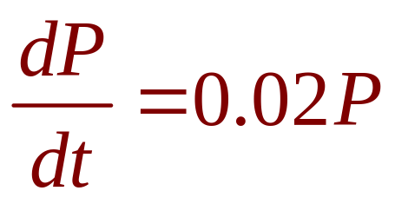
RELATIVE GROWTH RATE
For instance, if
and t is measured in years, then the relative
growth rate is k = 0.02 and the population
grows at a relative rate of 2% per year.
  If the population at time 0 is P₀, then the expression for the population is:
  P(t) = P₀e^{0.02t}

Slide 20
POPULATION GROWTH
Example 1
Use the fact that the world population was
2,560 million in 1950 and 3,040 million in
1960 to model the population in the second
half of the 20th century. (Assume the growth
rate is proportional to the population size.)
  What is the relative growth rate?
  Use the model to estimate the population in 1993
  and to predict the population in 2020.

Slide 21
POPULATION GROWTH
Example 1
We measure the time t in years and let
t = 0 in 1950.
We measure the population P(t) in millions
of people.
  Then, P(0) = 2560 and P(10) = 3040

Slide 22
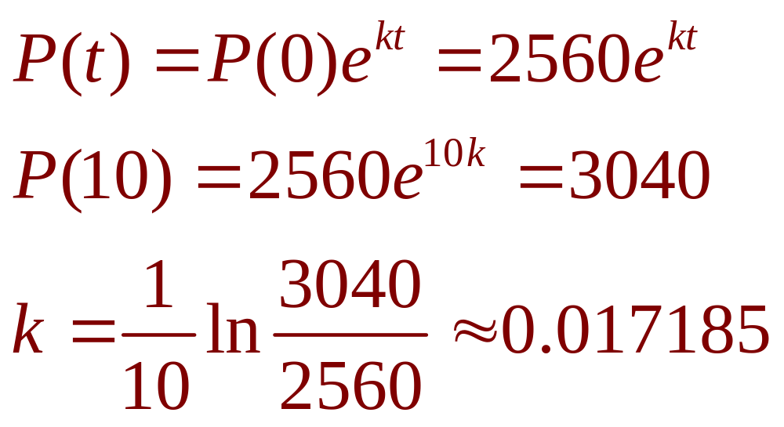
POPULATION GROWTH
Example 1
Since we are assuming dP/dt = kP,
Theorem 2 gives:

Slide 23
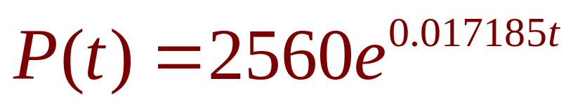
POPULATION GROWTH
Example 1
The relative growth rate is about 1.7%
per year and the model is:
  We estimate that the world population in 1993 was:
  The model predicts that the population in 2020 will be:

Slide 24
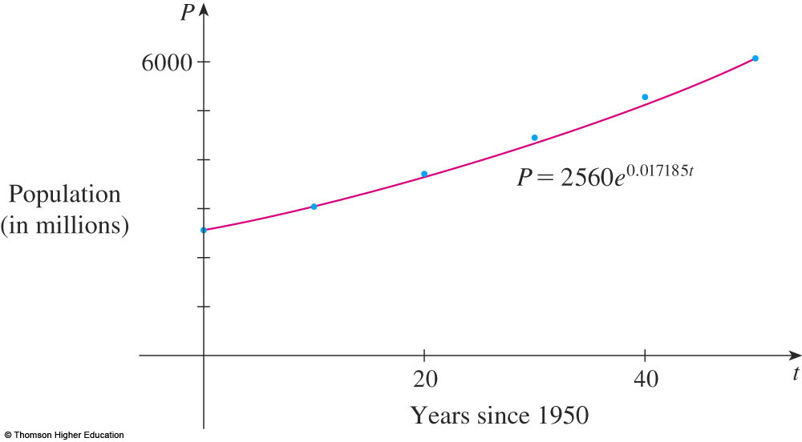
POPULATION GROWTH
Example 1
The graph shows that the model is fairly
accurate to the end of the 20th century.
  The dots represent
  the actual population.

Slide 25
POPULATION GROWTH
Example 1
So, the estimate for 1993 is quite reliable.
However, the prediction for 2020 is riskier.

Slide 26
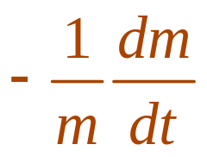
RADIOACTIVE DECAY
Radioactive substances decay by
spontaneously emitting radiation.
  If m(t) is the mass remaining from an initial
  mass m₀ of a substance after time t, then
  the relative decay rate
  has been found experimentally to be constant.
  Since dm/dt is negative, the relative decay rate
  is positive.

Slide 27
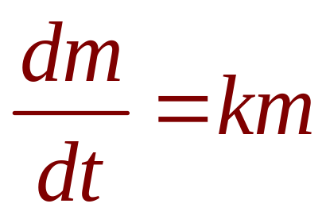
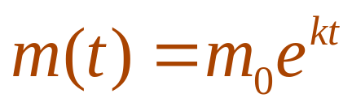
RADIOACTIVE DECAY
It follows that
where k is a negative constant.
  In other words, radioactive substances decay at
  a rate proportional to the remaining mass.
  This means we can use Theorem 2 to show that
  the mass decays exponentially:

Slide 28
HALF-LIFE
Physicists express the rate of decay
in terms of half-life.
  This is the time required for half of any given quantity to decay.

Slide 29
RADIOACTIVE DECAY
Example 2
The half-life of radium-226 is 1590 years.
  A sample of radium-226 has a mass of 100 mg.
  Find a formula for the mass of the sample that remains after t years.
  Find the mass after 1,000 years correct to
  the nearest milligram.
  When will the mass be reduced to 30 mg?

Slide 30
RADIOACTIVE DECAY
Example 2 a
Let m(t) be the mass of radium-226
(in milligrams) that remains after t years.
  Then, dm/dt = km and y(0) = 100.
  So, Theorem 2 gives:
  m(t) = m(0)e^{kt} = 100e^{kt}

Slide 31
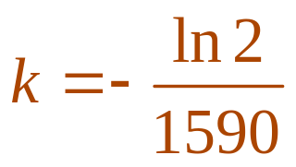
RADIOACTIVE DECAY
Example 2 a
To determine the value of k , we use the fact
that y(1590) = ½(100).
  Thus, 100e^{1590k} = 50. So, e^{1590k} = ½.
  Also, 1590k = ln ½ = -ln 2
  So, m(t) = 100e^{-(ln 2)t/1590}

Slide 32
RADIOACTIVE DECAY
Example 2 a
We could use the fact that e^{ln 2} = 2
to write the expression for m(t) in
the alternative form
m(t) = 100 x 2^{-t/1590}

Slide 33
RADIOACTIVE DECAY
Example 2 b
The mass after 1,000 years is:
m(1000) = 100e^{-(ln 2)1000/1590}
≈ 65 mg

Slide 34
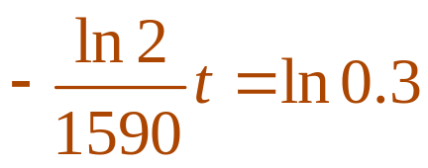
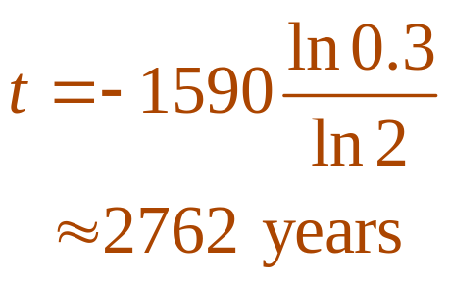
RADIOACTIVE DECAY
Example 2 c
We want to find the value of t such that
m(t) = 30, that is,
100e^{-(ln 2)t/1590} = 30 or e^{-(ln 2)t/1590} = 0.3
  We solve this equation for t by taking the natural logarithm of both sides:
  Thus,

Slide 35
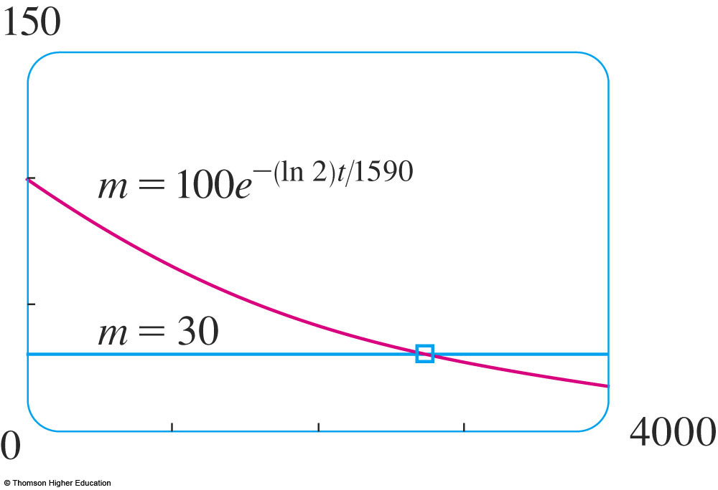
RADIOACTIVE DECAY
As a check on our work in the example, we
use a graphing device to draw the graph of
m(t) together with the horizontal line m = 30.
  These curves
  intersect when
  t ≈ 2800.
  This agrees with
  the answer to (c).

Slide 36
NEWTON’S LAW OF COOLING
Newton’s Law of Cooling states:
The rate of cooling of an object is proportional
to the temperature difference between the
object and its surroundings—provided the
difference is not too large.
  The law also applies to warming.

Slide 37
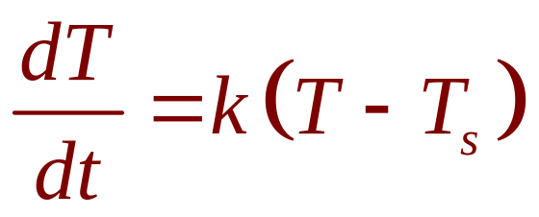
NEWTON’S LAW OF COOLING
If we let T(t) be the temperature of the object
at time t and T_{s} be the temperature of the
surroundings, then we can formulate the law
as a differential equation:
where k is a constant.

Slide 38

NEWTON’S LAW OF COOLING
This equation is not quite the same as
Equation 1.
So, we make the change of variable
y(t) = T(t) - T_{s}.
  As T_{s} is constant, we have y’(t) = T’(t).
  So, the equation becomes
  We can then use Theorem 2 to find an expression
  for y, from which we can find T.

Slide 39
NEWTON’S LAW OF COOLING
Example 3
A bottle of soda pop at room temperature
(72°F) is placed in a refrigerator, where
the temperature is 44°F. After half an hour,
the soda pop has cooled to 61°F.
  What is the temperature of the soda pop
  after another half hour?
  How long does it take for the soda pop
  to cool to 50°F?

Slide 40
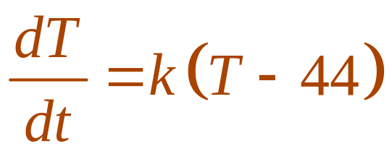
NEWTON’S LAW OF COOLING
Example 3 a
Let T(t) be the temperature of the soda
after t minutes.
  The surrounding temperature is T_{s} = 44°F.
  So, Newton’s Law of Cooling states:

Slide 41
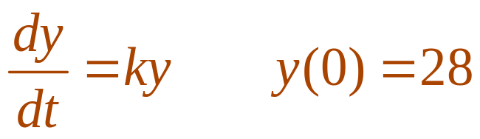
NEWTON’S LAW OF COOLING
If we let y = T – 44, then y(0) = T(0) – 44
= 72 – 44
= 28
  So, y satisfies
  Also, by Theorem 2, we have:
  y(t) = y(0)e^{kt} = 28e^{kt}

Slide 42
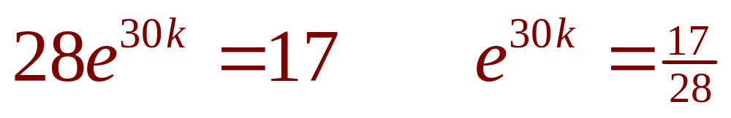
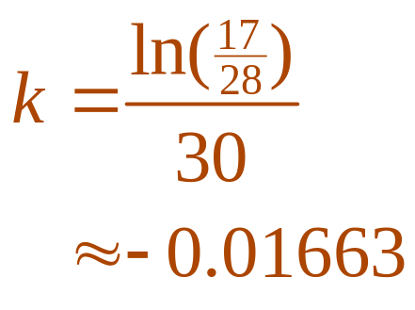
NEWTON’S LAW OF COOLING
Example 3 a
We are given that T(30) = 61.
So, y(30) = 61 - 44 = 17
and
  Taking logarithms, we have:

Slide 43
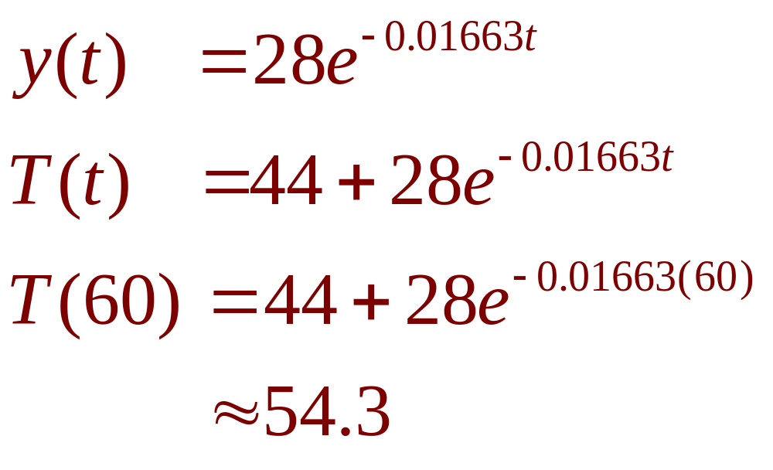
NEWTON’S LAW OF COOLING
Example 3 a
Thus,
  So, after another half hour, the pop has cooled
  to about 54°F.

Slide 44
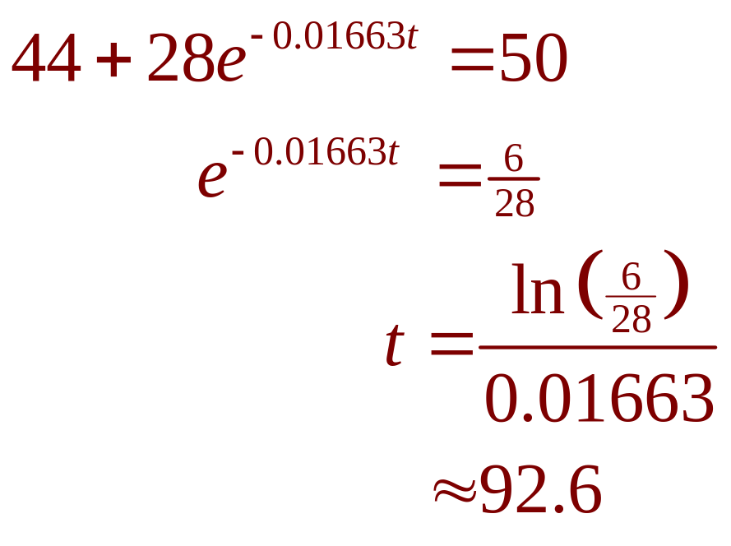
NEWTON’S LAW OF COOLING
Example 3 b
We have T(t) = 50 when
  The pop cools to 50°F after
  about 1 hour 33 minutes.

Slide 45
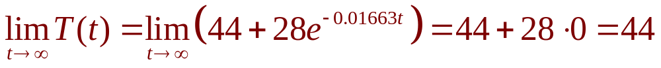
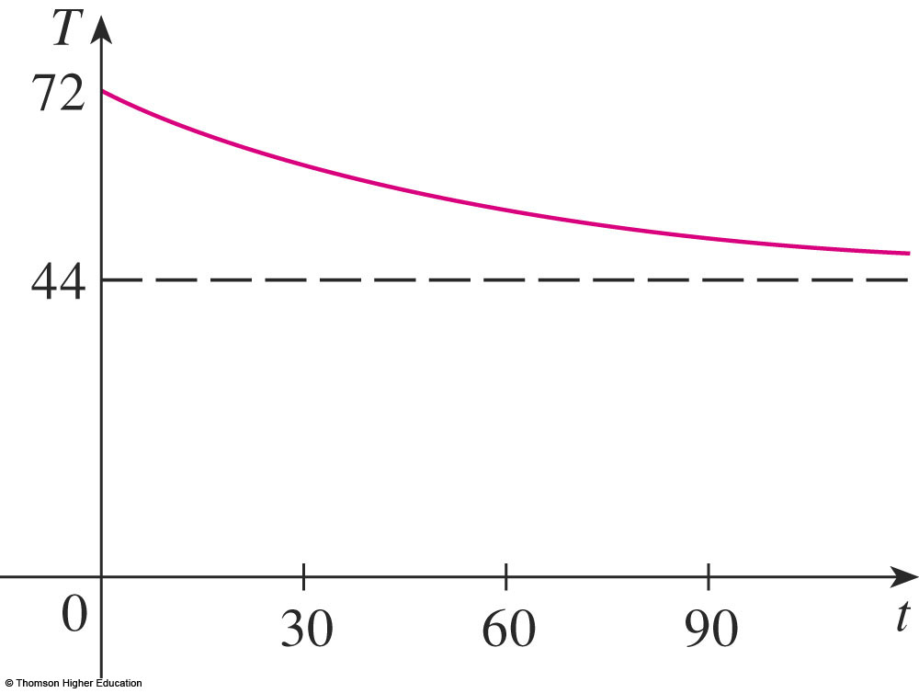
NEWTON’S LAW OF COOLING
In the example, notice that we have
which is to be expected.
  The graph of the
  temperature function
  is shown.

Slide 46
EXPONENTIAL GROWTH & DECAY
Finally, we will look at
an example of continuously
compounded interest.

Slide 47
CONTINUOUSLY COMPD. INT.
Example 4
If $1000 is invested at 6% interest,
compounded annually, then:
  After 1 year, the investment is worth $1000(1.06)
  = $1060
  After 2 years, it’s worth $[1000(1.06)] 1.06
  = $1123.60
  After t years, it’s worth $1000(1.06)^{t}

Slide 48
CONTINUOUSLY COMPD. INT.
Example 4
In general, if an amount A₀ is invested
at an interest rate r (r = 0.06 in this
example), then after t years it’s worth
A₀(1 + r)^{t}.

Slide 49
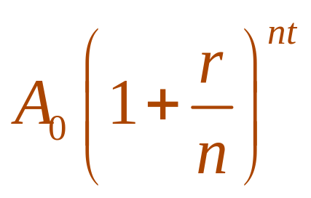
CONTINUOUSLY COMPD. INT.
Example 4
Usually, however, interest is compounded
more frequently—say, n times a year.
  Then, in each compounding period, the interest rate is r/n and there are nt compounding periods
  in t years.
  So, the value of the investment is:

Slide 50
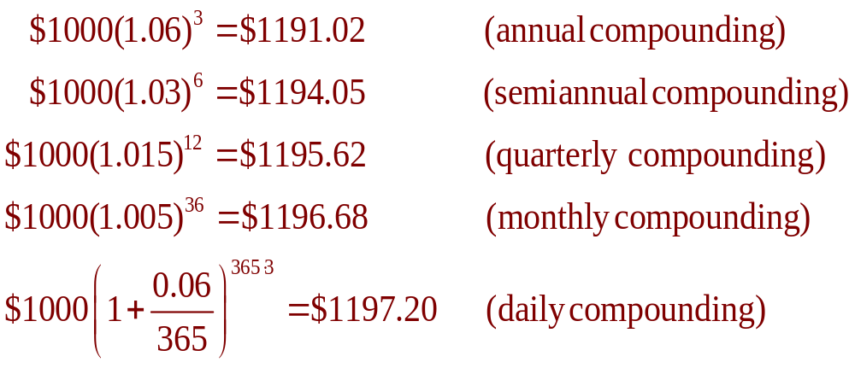
CONTINUOUSLY COMPD. INT.
Example 4
For instance, after 3 years at 6% interest,
a $1000 investment will be worth:

Slide 51
CONTINUOUSLY COMPD. INT.
Example 4
You can see that the interest paid
increases as the number of
compounding periods (n) increases.

Slide 52
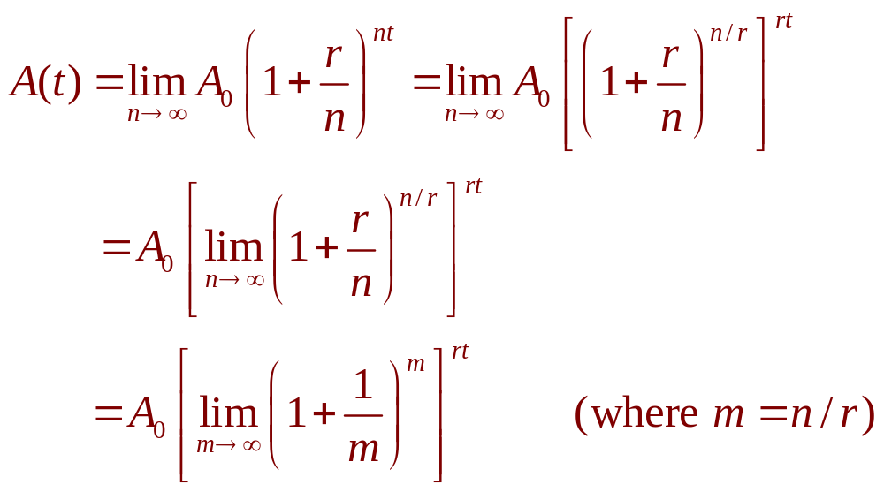
CONTINUOUSLY COMPD. INT.
Example 4
If we let n → ∞, then we will be compounding
the interest continuously and the value of
the investment will be:

Slide 53
CONTINUOUSLY COMPD. INT.
Example 4
However, the limit in this expression is
equal to the number e. (See Equation 6
in Section 3.6)
  So, with continuous compounding of interest
  at interest rate r, the amount after t years is:
  A(t) = A₀e^{rt}

Slide 54
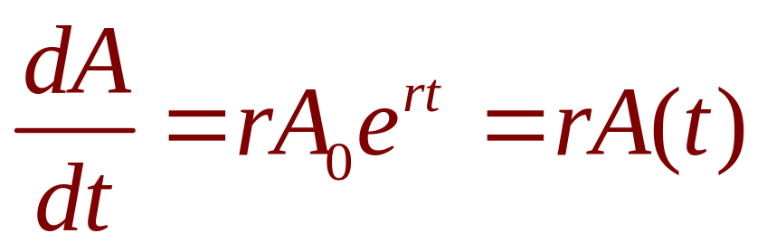
CONTINUOUSLY COMPD. INT.
Example 4
If we differentiate this function,
we get:
  This states that, with continuous compounding
  of interest, the rate of increase of an investment
  is proportional to its size.

Slide 55
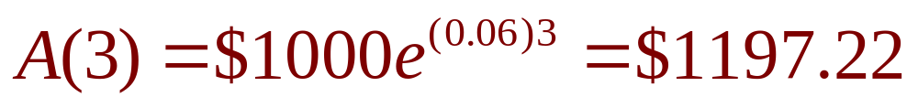
CONTINUOUSLY COMPD. INT.
Example 4
Returning to the example of $1000 invested
for 3 years at 6% interest, we see that,
with continuous compounding of interest,
the value of the investment will be:
  Notice how close this is to the amount we
  calculated for daily compounding, $1197.20
  However, it is easier to compute if we use
  continuous compounding.

